Slide 1

Subawards,
MTAs and CDAs in TUMarketplace
Presented by
Keith Osterhage and Terri Burt

Slide 2
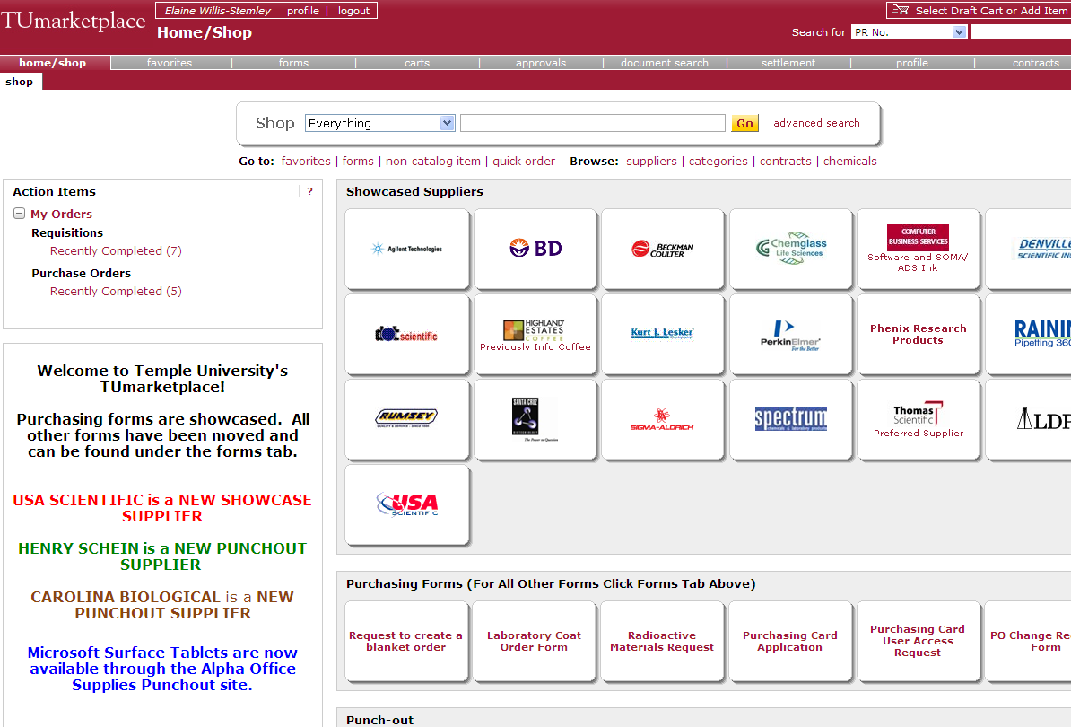

Slide 3
Contract approval request
FORM

Slide 4
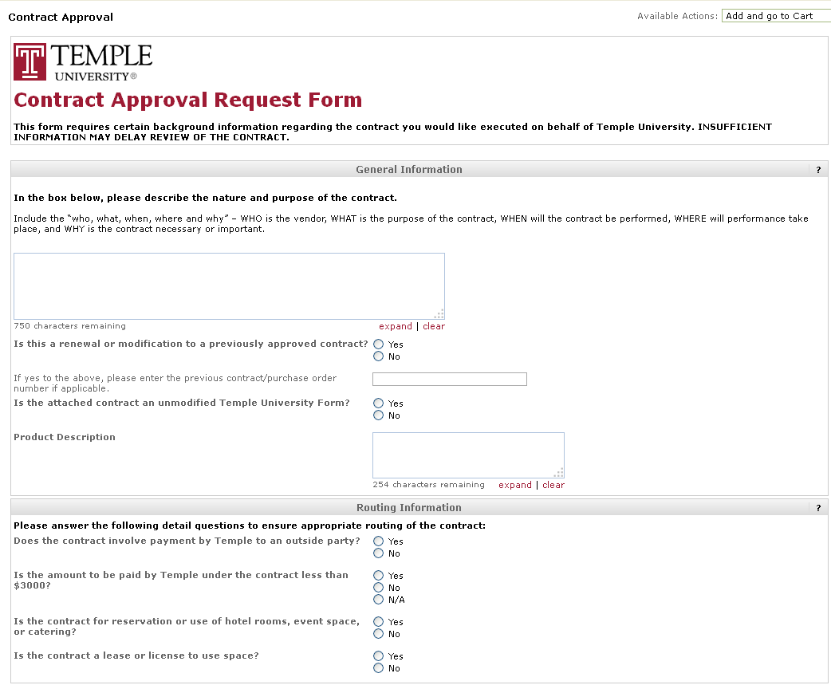

Slide 5
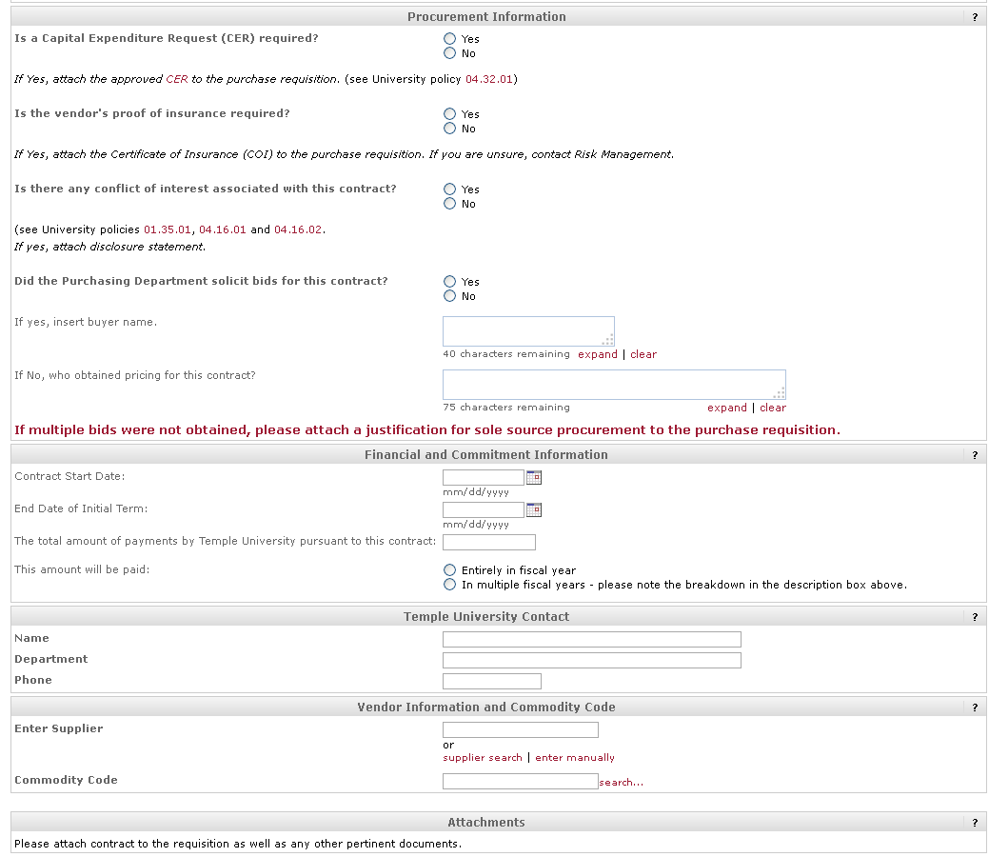

Slide 6
TUMARKETPLACE
INITIATOR
LEGAL
FINANCE

Slide 7

The Contract Approval Request form is the electronic form used to route all documents (there is no longer an FIS), and this is an e-FORM in
TUmarketplace.

Slide 8

For all “outgoing” Subawards, MTAs, CDAs (initiated by Temple as the prime), Research Administration staff will not need to use TUmarketplace or initiate the Contract Approval Request Form. Rather, the initiator (a PI or Department Administrator) will upload the email thread with Research Administration indicating they have done business with their contact in Research Administration to develop the final Subaward, CDA, MTA which they are uploading into TUmarketplace. At the conclusion of the approval process in TUmarketplace, the PI or Department Administrator will share proof of approval with their contact in Research Administration so that document can be sent out by Research Administration. (At the end of the approval process the signed contract will be attached to the requisition. The PI/Administrator would open that signed contract and email it to their contact in Research Administration so that Research Administration can send the contract out.)

Slide 9
For all “incoming” Subawards – where Temple is the Subawardee – the assigned Research Administration staff person will use TUmarketplace, initiate a Contract Approval Request Form and upload the Subaward. The Research Administration office must ensure that the PI/Department Administrator concur with the dates, budget, and scope of work in the final version and have documentation of that concurrence. Upon approval in TUmarketplace, the document will be sent out by Research Administration.

Slide 10
Other Sponsored Expenditures – faculty effort, hotels and travel, renting space, maintenance contracts, etc.– DO NOT COME through Research Administration. While all contracts go through TUmarketplace, these are not done by Research Administration. Research Accounting Services verifies, after the fact, that all such expenditures are allowable, appropriate, and allocable per the OMB circulars, and if in doubt, a PI or Department Administrator can check first before expending the funds.

