Slide 1

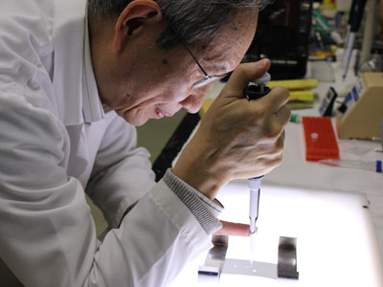
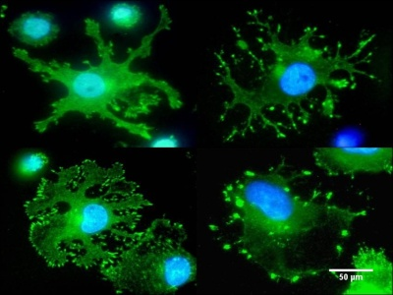
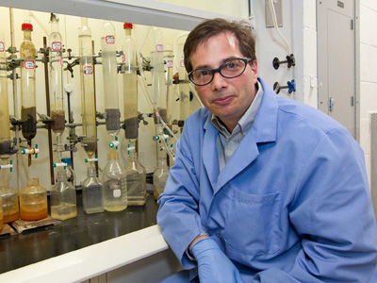

Technology Development and Commercialization
Presented by
Stephen G. Nappi, Director

Slide 2

Discovering Solutions
Laser-based bio and explosive threat detection
Standoff detection of explosives for security applications
Diagnosis of disease through tissue vaporization
Treatment for acid mine drainage and fracking
Two-tail lipid to inhibit acidic runoff from coal mines
Applicable to the fractate and flow-back pools used in hydraulic fracturing
Nanomaterials for Water Purification
Novel nanomaterials to remove emerging contaminants
Applicable to water and wastewater

Slide 3
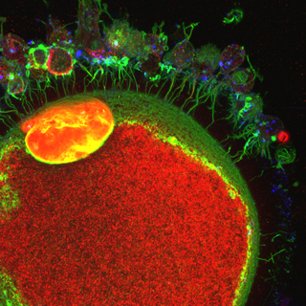
Discovering Solutions
Biomarkers of chronic obstructive pulmonary disorder
Early indicators and treatment responses for COPD patients
Developing a rapid, cost effective diagnostic kit
Determining egg quality to improve assisted reproduction
Clinical human assisted reproduction
Livestock propagation by enhanced ovulation and in vitro embryo production CLICK IMAGE FOR HIGH RESOLUTION PICTURE
Cocaine analogs for the treatment of addiction
No available synthetic methods for cocaine analogs
Potential therapeutic for drug addiction, ADHD, and neurological disorders

Slide 4
Developing Technology
Licensed (selected) Technology Under Development
Diagnostic technology for breast & other cancers (startup)
Treatment for type II diabetes and obesity (small company)
Treatment for Acute Myeloid Leukemia
Fare collection technology for transit systems (large company)
Endoscopic Suturing Device for Weight Loss
Biosensor for detecting chemical agents (large)
Devices to increase the flow rate of fluids through pipelines, including fuel and chocolate
Therapeutic agents for the treatment of viral infections, including HIV, CFS, hepatitis B (small-international)

Slide 5
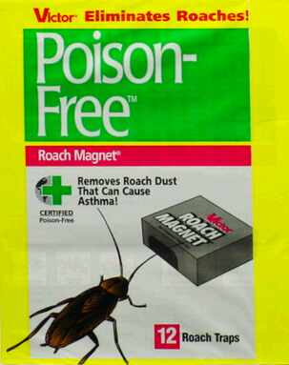

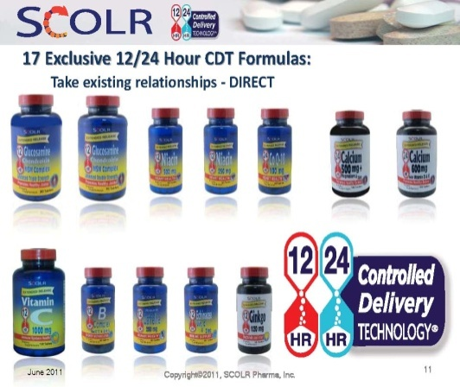




Temple-Invented Products

Slide 6
Spinning out New Businesses
Diffregen, LLC
Niche therapy that converts “differentiates” cancerous cells to normal cells
Applications for skin cancers and wrinkle reduction
Proplex Technologies
Diagnostic and Therapeutic for Breast Cancer
Applications for prostate, brain, and other cancers
pureNano Technologies
Purification of Carbon Nanotubes for Electronics
Highest purity levels with significant cost and processing time savings

Slide 7
Invention Disclosures

Slide 8
Licenses/Options Executed

Slide 9
Gross Licensing Income

Slide 10
How it Works: Key Terms
Bayh-Dole Act
Invention and Patent Policy
Invention Disclosure
Patent application (provisional, utility, PCT)
Copyright
U.S. Patent and Trademark Office (USPTO)
U.S. Copyright Office
Confidentiality Agreement
License/Option Agreement
Material Transfer Agreement

Slide 11
Assessing New Inventions
2
Internal Review: Feedback within 4 weeks
3
Patentability Opinion within 2 weeks
Go/No Go
Go/No Go
4
Provisional Patent Protection Secured for One Year
Go/No Go
Marketing activities initiated, partners targeted, feedback received
1
Disclose the invention via http://www.temple.edu/ovpr/ott/disclosure_process.html

Slide 12
Evaluation Considerations
Type of Invention
  Method or Process: Can it be enforced?
  Software: Copyright protection applies. Is a patent justified?
  Composition of matter (NCE): Do you have preliminary data?
  Device: Has a working prototype been developed?
Commercial Potential
  Think product backwards
  What development steps are next?
  Who will buy?
  What company will manufacture and sell?
Patent Potential
  Novelty: Is there anything similar in the public domain?
  Enablement: Can you demonstrate the invention to someone skilled in
  the art? Do you have the recipe to duplicate the invention?
  Non-obviousness: Does a single or a combination of references give
  other subject matter experts sufficient information to create the
  invention?

Slide 13
Evaluation Considerations
Inventorship
  Apply this test: Conception v. Execution
  Authorship does not equal Inventorship
  Courtesy inventorship can lead to invalidation
  Non-Temple Inventors may equal joint ownership
  Inventorship is a legal determination – Temple’s patent counsel will
  decide
Sponsor Obligations
  Confidentiality
  IP Ownership and license rights
  Royalty sharing
  Publication
  Acknowledgement
Relevant Publications
  Will help determine scope of patent
  Must be disclosed to the USPTO

Slide 14
Working with Industry
Finding the Right Company
  Active role in identifying external POC funds (internal funding, Science Center, Ben Franklin, BioAdvance, BioStrategy Partners)
  Creative marketing to identify licensing partners or entrepreneurs (social networking, conference participation)
  Building value internally through expert-guided development funding and business plans (Fox School, Drug Discovery Center, App Center)
  Attracting industry partners through business development
Negotiating the Deal
  Creative deal-making approach for companies interested in a license
  Express deal-making approach for startup companies
  Terms based on industry standards and technology value
  Common negotiation tactics

Slide 15
Income Distribution
Net Income = Gross income less patenting, legal, and marketing costs related to an invention
University's share of Net Income is less than or equal to $500,000 | University's share of Net Income is greater than $500,000
40% to Inventors | 40% to Inventors
20% to OTT | 20% to OTT
14% to Department or Research Unit | 4% to Department or Research Unit
6% to College or School | 4% to College or School
20% to University | 32% to University

Slide 16
Startups Process
Creating a Path to Market
Criteria
Appropriate Technologies
Management Identified
Potential Conflicts Resolved
Agreements Executed
Business Plan Developed
Minimum Funding Achieved
Development Milestones Completed
Full License Activated

Slide 17



Optimizing the
Commercialization Process
Patent Counsel
Protection
Licensing/
Startup
Evaluation
Marketing
POC Funding
Product Dev/
Incubation
BioSP
IEI
EMC
Invention
Commercialization
Research
Marketplace
MADV
USCS
QED
BFTP – ECI/NTI

Slide 18
Top 10 Points to Remember
Inventions should be disclosed upon conception
Inventorship is a legal determination made by patent counsel
Patent applications must precede public disclosure
Disclosure includes journal articles, posters, oral & pre-conference abstracts
Disclosure of unpublished information must be protected by a confidentiality agreement
Material transfer agreements are necessary for all incoming and outgoing tangible research materials
Material transfer and sponsored research agreements may contain confidentiality, publication, and intellectual property requirements
Potential conflicts of interest must be reported if inventors have an interest in a spinout company
An IP Rider should be signed for consulting agreements, which often conflict with the University policies and employment agreements
Patents do not hinder publication

Slide 19
Contact Information
Stephen G. Nappi
Ph: 215-204-5293
snappi@temple.edu
www.temple.edu/research/otdc
Stay Connected

