Slide 1

Introduction to the IRB
Chad Pettengill, J.D., M.I.B.
IRB Director
November 15, 2012

Slide 2
Topics in this presentation
What is human subjects research?
Review process
Noncompliance
Resources

Slide 3

#1 Question: when are you going electronic?
Expected launch date: January
Plenty of training opportunities

Slide 4
Mission of the IRB
To ensure the protection of rights, privacy, and welfare of human participants in research conducted by Temple University faculty, staff, and students.
One IRB office at HSC/all campuses, entities

Slide 5
What is human subjects research?
The IRB reviews human subjects research. The activity has to be considered "research" and has to involve "human subjects" for the IRB to review it.
We follow FDA and DHHS definitions of those terms. For today’s purpose, we will use the DHHS definitions.

Slide 6
DHHS definition of “research”
45 CFR §46.102 (d): research is a systematic investigation. . . designed to develop or contribute to generalizable knowledge.

Slide 7
Breaking down the definition
  Investigation- a searching inquiry for facts; detailed or careful examination
  Systematic- Having or involving a system, method, or plan
  Knowledge- truths, facts, information
  Generalizable (widely applicable)

Slide 8
Research results do not have to be published or presented at a professional meeting to qualify the experiment or data gathering as research. From DHHS' perspective, the contribution to generalizable knowledge makes the activity research, regardless of publication or presentation.

Slide 9
A person cannot circumvent the definition of research by claiming that there was no intent to develop or contribute to generalizable knowledge. The IRB evaluates the investigator's proposed actions and behavior, rather than the investigator's intent, to discern the design of the activity.

Slide 10
DHHS definition of “human subject”
45 CFR §46.102 (f): Human subject is a living individual about whom an investigator conducting research obtains:
Identifiable private information
OR
Data through intervention or interaction with the individual (does not have to be identifiable private information)

Slide 11
Breaking down the definition
Data through intervention
(Physical procedures or manipulations of those individuals or their environment for research purposes)
or interaction with the individual
(Communication or interpersonal contact with the individuals)

Slide 12
Breaking down the definition, contd.
Identifiable information- individuals’ identities can be readily ascertained or associated with the information by the investigator.
Private information- The data are about behavior that occurs in a context in which an individual can reasonably expect that no observation or recording is taking place (e.g., restroom) or individuals have provided the data for specific purposes in which the individuals can reasonably expect that it will not be made public (e.g., medical record).

Slide 13
In other words, human subjects research can occur without any intervention or interaction with individuals.
Examples:
  analysis of data or biological specimens
  medical chart review studies

Slide 14

Example: human subjects research?

Slide 15
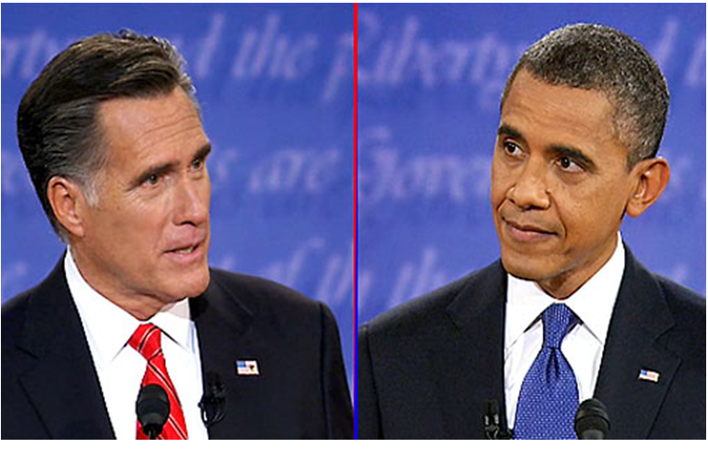
Example: human subjects research?

Slide 16
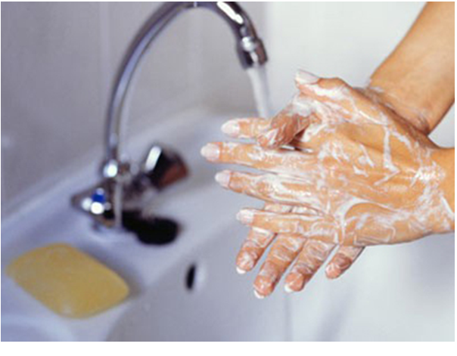
Example: human subjects research?

Slide 17
Review process
Human subjects research is reviewed via three methods:
a convened IRB (aka full board)
expedited review
or is deemed exempt

Slide 18
Exempt research
45 CFR §46.101(b) states that certain categories of research are exempt from DHHS oversight of human subjects research.

Slide 19
Then why do I have to submit exempt research to the IRB for approval?
OHRP (Office for Human Research Protections) recommends (and Temple agrees) that institutions review exempt human subjects research.
Reasons:
  Investigators have a conflict of interest in reviewing their own study.
  Investigators may not be as familiar with the human subjects regulations as the IRB and may think a study is exempt when it is not exempt.

Slide 20
Expedited research
45 CFR §46.110(a) lists the categories of research that are eligible for expedited review.
(we have a checklist for that)

Slide 21

Q: Do I have to request a certain level of review, e.g., exempt or expedited?
A: No. We always assign the lowest level of review to an item. For example, if a study is eligible for exempt or expedited status, we will not assign it to a convened meeting.

Slide 22
Full Board review
Four boards/month:
  Two medical research boards
  One social and behavioral research board
  One board that reviews Unanticipated Problems (“UPRs”) and issues of noncompliance

Slide 23
Three Applications
  Application for Human Research
    Most common
    Use for new studies – covers medical and social and behavioral studies.
    Requires supplemental documents, such as a protocol. See signature page of the application.
    Items requiring full Board review are placed on the agenda of the “next available Board.”

Slide 24
Application for Classroom Project/Activities
Use if the professor requires his/her undergraduate students to conduct human subjects research as part of a Classroom Project/Activity.
In contrast, the Application for Human Research should be used for graduate students or if a professor requires an undergraduate student to conduct human subjects research as part of a Capstone Project (intensive, active learning project requiring significant effort in the planning, implementation, and preparation of a substantial final written work product) or similar project.

Slide 25
HUD Application
Humanitarian Use Device- a medical device that is intended to benefit patients by treating or diagnosing a disease or condition that affects or is manifested in fewer than 4,000 individuals in the United States/year.
Rarely used at Temple.

Slide 26

Check the IRB website to find current versions of forms. Don’t save to desktop.
Provide one original for each form (we don’t need copies).
We don’t need a cover letter or submissions on your Department letterhead.
When submitting a response, use the “Modifications required to secure approval of human research” form. Otherwise, we may review it as a new item.

Slide 27
IRB approval occurs when you receive the IRB approval letter.

Slide 28
IRB approval does not occur:
  Upon submission to the IRB
  If the study is “approved pending modifications required to secure approval”

Slide 29
IRB approval= IRB approval
i.e., other approvals may be required before starting the study. Examples:
  Environmental Health & Radiation Safety (EHRS), Institutional Biosafety (IBC), or Animal Care and Use (IACUC)
  City, state, county laws, codes, ordinances, etc.

Slide 30

Example

Slide 31
Post-IRB approval: now what?
Modification of Approved Human Research
  Must obtain IRB approval before implementation of modifications.
  Applies to exempt studies.
  Required for every modification, even if the modification is minor.

Slide 32

Include any documents affected by the modification, e.g., revised protocol.
Submit highlighted versions of documents to indicate changes, rather than underlined text or bolded text.

Slide 33
Post-approval, contd.
Reportable New Information form
Report information if the information meets the criteria on page 2 of the form. A few examples:
Unanticipated Problem (“UPR”)
Breach of confidentiality
Protocol deviation

Slide 34
Reportable New Information form, contd.
If it doesn’t meet the criteria, don’t submit it.
Note- you may have other reporting requirements (e.g., FDA and sponsor).
Can apply to social and behavioral studies.

Slide 35
Post-approval, contd.
For expedited and full Board studies: Continuing Review Progress Report
Submit at least annually

Slide 36

Our database sends automated renewal reminders to you.
If the IRB does not review the form by the IRB approval end date, the IRB will close the study. The regs do not provide any flexibility in this area.
Submit the form early. Allow time for the IRB to review it. Example: study approval period ends tomorrow.
If simultaneous change, submit a modification separately. Reason: each may have different levels of review + possible revisions in one item may delay the other item.

Slide 37
Final Report
Use this form to close a study.

Slide 38
Noncompliance
IRB approval is required for human subjects research.
IRB approval is not optional or “best practices.”

Slide 39
Example re-visited

Slide 40
Example, contd:
Activity done and publication and IRB application:
The IRB cannot approve an activity after it has been done.
+
Review by the UPR Board for noncompliance

Slide 41
Potential consequences
If the IRB makes a determination of serious non-compliance or continuing noncompliance:
  The determination may be reported to the FDA and OHRP.
  The Senior Vice Provost for Research and Graduate Education, Department Chairperson, and Dean will be notified.

Slide 42
Your research privileges at Temple University or with federal agencies (e.g., FDA) may be restricted.
You may feel the need to hire outside counsel to represent you.

Slide 43
The FDA, OHRP, and other monitoring agencies may audit your studies.
The FDA, OHRP, and other monitoring agencies may audit Temple University.

Slide 44
The reputation of Temple University may be affected.
The research enterprise at Temple University may be affected.

Slide 45
Resources
You have, via our website, all the tools that the IRB uses.

Slide 46
Examples of resources
Human Research Determination Worksheet
Criteria for Approval Worksheet
Scientific or Scholarly Review Worksheet
FAQ section
Investigator Manual

Slide 47
Training/education
Join the IRB listserv
Monthly webinars
One-on-one training
Classroom training
Departmental or College training
Contact our trainer: naomi.starkey@temple.edu

Slide 48
Conclusion
Don’t violate subjects’ rights.
Ask the question, “Is this human subjects research?”
Consult the IRB website http://www.temple.edu/research/regaffairs/irb/index.html and contact the IRB with your questions: irb@temple.edu

Slide 49

15 minutes. . .
15 minutes may save a lot of time in the long run.
Obtain IRB approval before implementation of a study or its changes.
Don’t risk your and Temple’s reputation.

