Slide 1


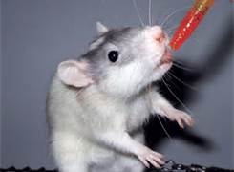
IACUC and Compliance Overview and Updates
Sheera M. Dashkow, MLAS, GVT, CPIA
IACUC and Compliance Director

Slide 2

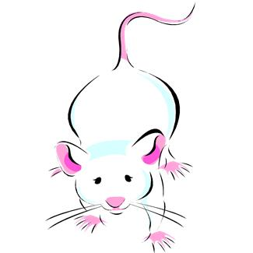

IACUC- Institutional Animal Care and Use Committee
We as a research community are charged by the public with the responsibility to assure animal welfare in exchange for the privilege of utilizing animals in the advancement of human welfare.

Slide 3
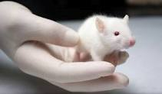
Role of the IACUC
Review protocols that involve the use of live animals.
Review of entire animal care program every 6 months
Inspection of all animal facilities and lab areas every 6 months
Address animal welfare concerns
Responsible for reporting any instances of non-compliance and recommending corrective action.

Slide 4
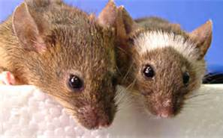
Alternatives
Current regulations stress the need to search for and develop alternatives to procedures on animals that cause more than momentary pain or distress. The concept of the 3 "R"s has been used when thinking about alternatives to animal use. This concept was developed in 1959 by Russell and Burch in their book: The Principles of Humane Animal Experimental Techniques.
The 3 "R"s are Replacement, Reduction, and Refinement. Investigators at Temple, who use animals that may undergo more than momentary pain or distress, must consider the 3 "R"s in the design of their experiments or teaching protocols and must demonstrate their search for alternatives.
Contact Karen Burstein, Senior Reference Librarian
Burstein@temple.edu 215-707-1329

Slide 5
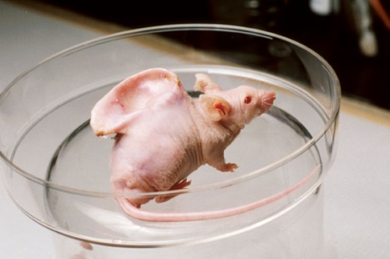
IACUC at Temple
The IACUC, which is a committee mandated by the AWA and the PHS policy, reviews and must approve all activities involving vertebrates at Temple. The AWA and PHS policy state membership requirements for the committee:
1veterinarian (with laboratory animal background and responsibility at the institution),
1 member of the community (to represent the public interest),
1 scientist who uses animals in research
1 non-scientist member
The committee must have at least 5 members, currently our committee has 20 members.

Slide 6
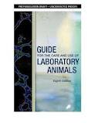


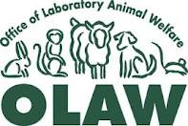
IACUC at Temple University
The Guide for the Care and Use of Laboratory Animals
AAALACi-Association for the Assessment and Accreditation of Laboratory Animal Care-International
USDA-United States Department of Agriculture
AWA-Animal Welfare Act
OLAW-Office for Laboratory Animal Welfare
AALAS-American Association of Laboratory Animal Science

Slide 7
Regulatory Oversight of Animals Used in Research
USDA
(United States Department
Of Agriculture)
PHS
(Public Health Services)
AAALAC, International
(Association for the Assessment and
Accreditation of Laboratory Animal
Care International)
NIH
(National Institute Of Health)
APHIS
(Animal and Health Plant Inspection Services)
OLAW
(Office of Laboratory Animal Welfare)
AWA (Animal Welfare Act)
“The Guide” (The Guide for the Care and Use of Laboratory Animals)
TEMPLE UNIVERSITY
IACUC
(Institutional Animal Care & Use Committee)
ACUP or Protocol
(Animal Protocol)
Investigator

Slide 8
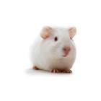
New IACUC Compliance Coordinator
Mary Kate Goldy, MLAS, LATG
Implementation of a new post approval monitoring program.
Starting with USDA protocols
Information on Animal Protocols remains up-to-date and in compliance.
Foster a teamwork environment between the laboratories, ULAR and IACUC.
Allow for an exchange of information and education.
Create consistency in policies which allows consistency in research performed at the University.
Our purpose is to allow your research to proceed without interruption or jeopardy!

Slide 9
New IACUC Program Coordinator
Lisa Panchella, MLAS, LATG
Implementation of the eRA module for electronic protocol submission
Start-up for the project is anticipated for July 2013
Allow investigators to electronically submit protocols, amendments, and annual reviews.
Allow for IACUC members to review protocols electronically.
Training will be offered to PIs and lab staff.

Slide 10
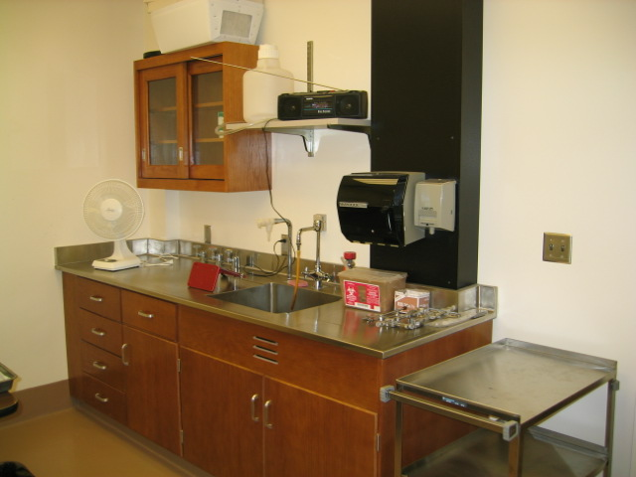
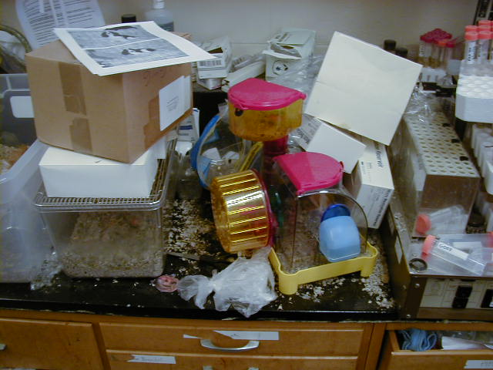
Common Compliance Issues
Or…Is This Your Lab?
Is This Your Lab?

Slide 11
Common Compliance Issues
Investigators or lab personnel working with animals before the protocol is approved
Additional investigators or lab personnel working with animals before they have been formally added and approved to work on a protocol via an amendment
Performing procedures not approved in a protocol
Not performing procedures approved in a protocol
Animals in-house on an expired protocol
Expired drugs

Slide 12
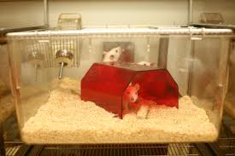
Animals being used or housed in laboratories without prior IACUC approval
Animals cannot be kept outside of the animal facilities
for more than 12 hours (USDA species) or 24 hours (rodents)
without IACUC approval.
This is a federal requirement!!!
All animal labs and housing areas must be inspected and
approved by the IACUC before animal work can begin.

Slide 13
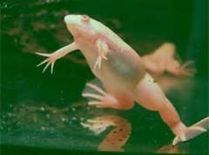
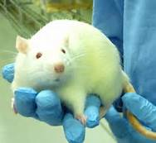
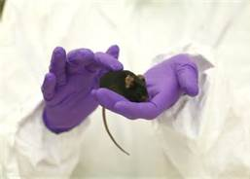
IACUC Resources
IACUC Website
http://www.temple.edu/research/login.asp?val=iacuc
AALAS Learning Library
https://www.temple.edu/researchapps/aalas/AALAS_Login.aspx

Slide 14
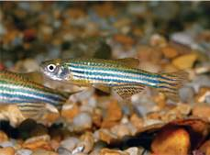
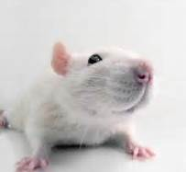
IACUC Resources

Slide 15
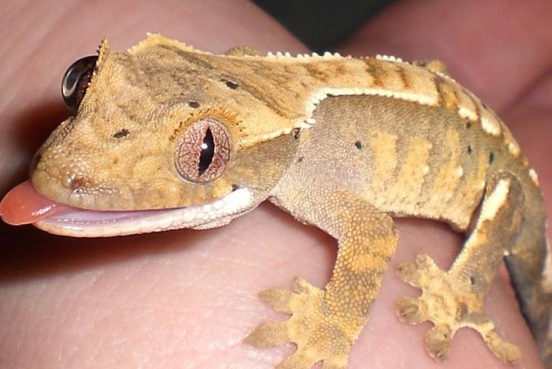
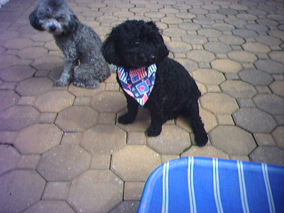
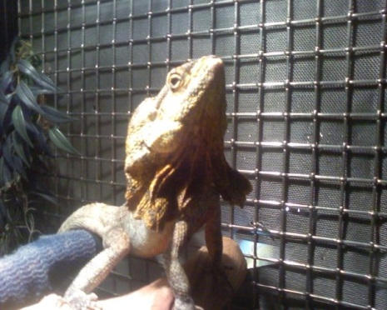
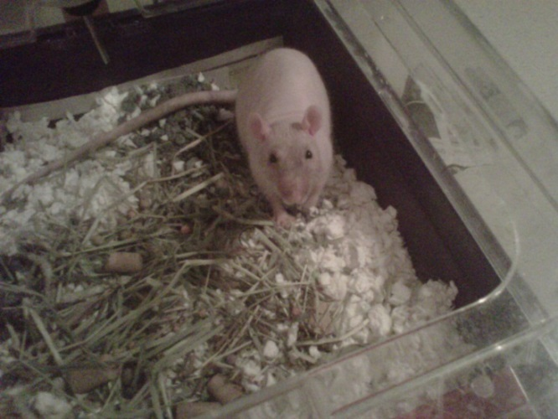
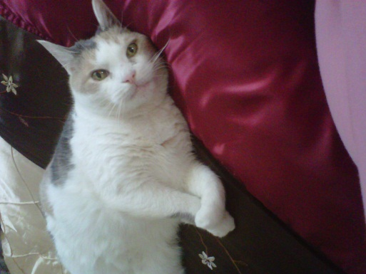
Questions??

