Slide 1
Institutional Advancement
Temple University
May 2012

Slide 2
Institutional Advancement
The Office of Institutional Advancement
The Office of Institutional Advancement serves Temple University through Alumni Relations, Major Gifts, Annual and Planned Giving, Corporate & Foundation Relations, Communications and other Development Support Services. Advancement Office staff work collaboratively with other Temple staff and faculty to build relationships among Temple’s alumni and friends. Through these contacts the Advancement Office secures the partnerships necessary to ensure the future success of Temple University.
Key Areas:
Alumni Relations
Major Gifts
Planned Giving
Annual Giving
Corporations and Foundations Relations
Stewardship
Prospect Management
Operations
Communications and Marketing

Slide 3
Why Fundraise?
There are four primary sources of revenue for the University:
Tuition
State Appropriations
Sponsored Research and Tech Transfer
Contributions/Private support
  FY12: $57 million goal
  FY13: $70 million goal
  FY20: $100 million goal

Slide 4
The Future of Temple
Core Values
Access to excellence and opportunities for success for all students
Creation and application of knowledge
Excellence in teaching and wide-reaching assessment of learning
Ethical, social and community responsibility
Cultural and global awareness
Investigation, innovation and entrepreneurship
Commitment to sustainability
(from the Temple University Academic Strategic Compass: Executive Summary)

Slide 5
The Future of Temple
Target Points for Success
Recruit students of promise, including high school graduates and transfers, graduate and non-traditional students while sustaining Temple's hallmark diversity
Improve retention and graduation rates of undergraduates through more personalized academic advising and mentoring
Promote excellence in teaching
Utilize assessment to improve curriculum and pedagogy
Seek young scholars and artists in their respective fields, particularly where extramural funding is available, to replace retiring faculty
(Temple University Academic Strategic Compass: Executive Summary)

Slide 6
The Future of Temple
Target Points for Success continued:
Achieve Very High Research Activity through substantial investment in the research infrastructure.
Encourage increased externally sponsored research
Increase numbers of international students and faculty and expand opportunities for Temple students and faculty to study and conduct research abroad
Expand the number of artistic and creative performances and exhibitions on campus; increase attendance at these events
Make Temple a destination for students, alumni, faculty, staff, the community and visitors from around the world

Slide 7
Areas for Support
Students
Temple provides talented students of every background with access to an excellent education. To make this education affordable, we offer both need-based and merit-based financial aid, scholarships for study abroad and independent projects and opportunities for unique externships.
Facilities
Today more than 12,000 students live on and around Temple's Main Campus, creating a vibrant residential community. We provide these students with superb facilities, such as new buildings for the Fox School of Business and the School of Medicine, a Main Campus home for the Tyler School of Art, an addition to Presser Hall, renovation of the Temple Performing Arts Center (formerly the Baptist Temple) and many other improvements across campus.
Faculty
Temple professors continue to distinguish themselves through their commitment to teaching, inspiring students with their knowledge and dedication, in the classroom and beyond. This is true of senior faculty members who have taught at Temple for decades, and of the new scholars who have joined us from top universities nationwide.
Research
As Temple strives to provide its students with an enriching and challenging experience, research plays a critical role. A thriving program attracts top faculty and generates new learning opportunities. Temple students now have unprecedented opportunities to join faculty in original research and creative projects.
Community
Temple is an integral part of North Philadelphia, the Delaware Valley and the global community. We develop programs of study, establish research centers, forge partnerships and launch outreach efforts all responding to current needs in our community and in society. In return, life and learning at Temple are immensely enriched by our connections with the world beyond our campuses.

Slide 8
Financial Summary
From Fiscal Year 2011 Annual Report
Temple University/Temple University Health System
Fiscal Year 2011 – Including Educational Support Services and Consolidating Eliminations (in millions of dollars, rounded)
Revenues Total: $2,220.04
Notes:
OTHER MATTERS – AUXILIARY ENTERPRISES
Auxiliary operations were $$79.6M in FY11. Top category is University Housing ($48M). Also includes parking, Liacouras Center and off campus residence halls and Temple Press. Bookstore, TPAC, foodservices.
Three auxiliaries – Temple University Press, Intercollegiate Athletics and Off-Campus Housing require a subsidy from the University.

Slide 9
Financial Summary
From Fiscal Year 2011 Annual Report
Total Philanthropic Support
Fiscal Years 2001-2011
TOTAL DOLLARS
TOTAL DONORS
In millions of dollars
In thousands

Slide 10
Who Supports Temple?
Temple Community is comprised of…
  Alumni
  Students
  Parents
  Friends
  Faculty and Staff
  Trustees
  Corporations
  Foundations
  Government support

Slide 11
What is a Gift?
Cash, stock, or other assets
Can be made once or in installments
Gifts can be pledged and paid off over a number of months or years
Restricted = donor decides where to allocate the money
Unrestricted = Temple decides where to allocate the money
Individual donors can often have their gift matched by their employer – “matching gifts”

Slide 12
Solicitation Lifecycle
Solicit
Identify
Cultivate
Steward
Length of time spent cultivating a donor often is dependent on the size of gift;
generally, the larger the gift (e.g., a Leadership Gift), the longer the lifecycle.

Slide 13
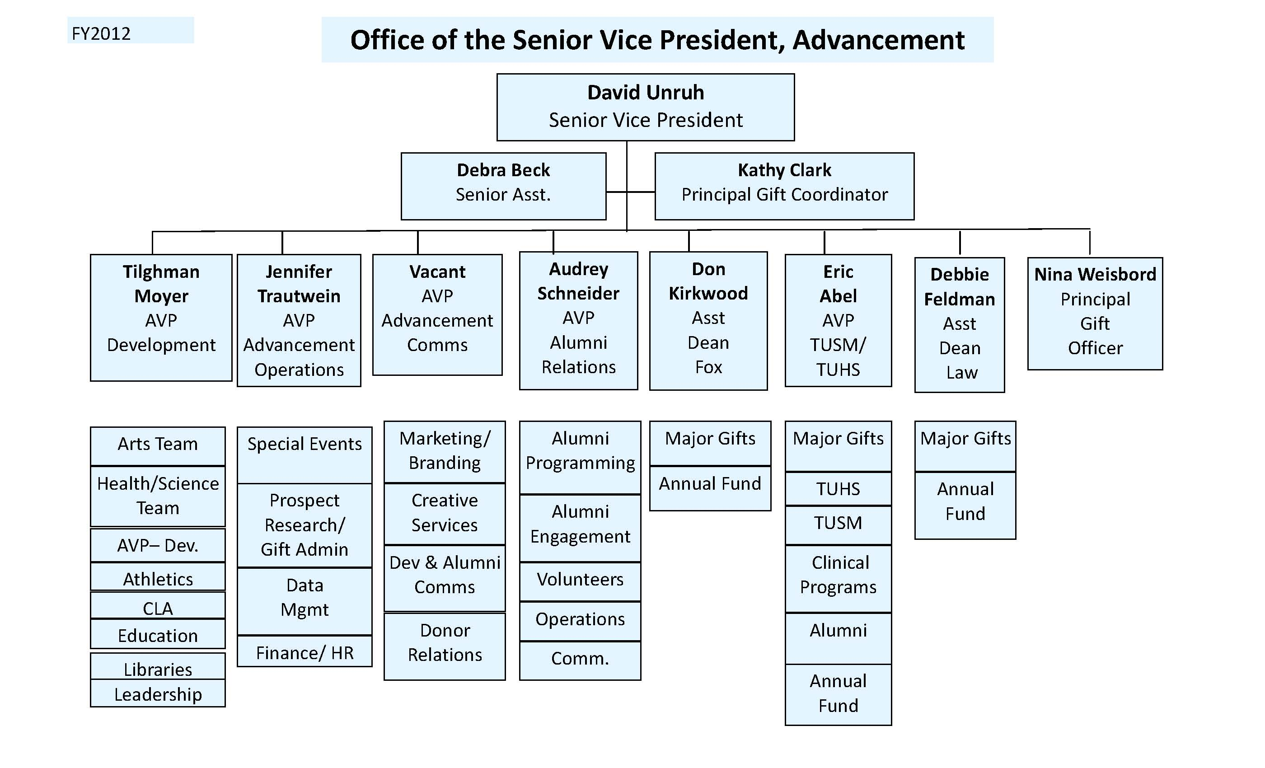
Nicole Naumoff
AVP
Advancement
Comms

Slide 14
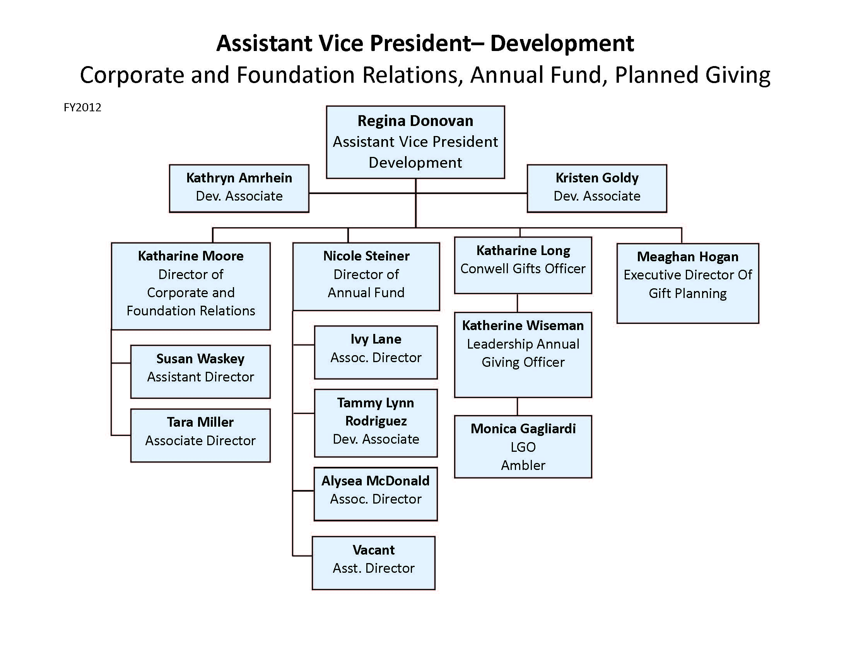
Central Development Support Team
Corporate and Foundation Relations, Annual Fund,
Individual Gifts, Gift Planning
Kate Moore
Director of Corporation and Foundation Relations
Nicole Steiner
Executive Director of Annual Fund
Kate Long
Director of Individual Gifts
Katharine Wiseman
Individual Gift Officer
Monica Gagliardi
Individual Gift Officer

Slide 15
Annual Fund
Gifts made on a recurring, annual basis (July 1- June 30). Short solicitation cycle.
Focus: Gifts of $999 and under. Primary goal is participation, not dollar amount. “Bodies in the door”.
Audiences: Alumni, Parents, Friends, Faculty/Staff, Students (Tfund)
Channels: print, phone, e-mail, online
Recognition Society: Loyal T Society (recognizes consecutive giving)
Team: Nicole Steiner, Ivy Lane, Tammy Rodriguez, Alysea McDonald

Slide 16
Individual Gifts
Gifts made on a recurring, annual basis (July 1- June 30). Short solicitation cycle.
Focus: Gifts of $1k - $50k (an extension of the Annual Fund) Primary goal is increasing revenue and uncovering future Leadership Gift prospects.
Audiences: Alumni, Parents, Friends, Faculty/Staff
Channels: print, phone, e-mail, online, in-person
Recognition Society: Conwell Society (recognizes donors who invest $1k and above)
Team: Kate Long, Monica Gagliardi, Katharine Wiseman

Slide 17
Leadership Gifts
“Gifts of a lifetime”; gifts made once to Temple. Longer solicitation cycle; provide immediate support to Temple.
Gifts are very specific and tailored to donor interest/need.
Focus: Gifts of $50k - $999k
Audiences: Alumni, Friends, Parents
Channels: in-person
Recognition Society: Conwell Society (recognizes donors who invest $1k and above)
Team: Central: Ashley Lomery, Melissa, Kapustin, Star Hamilton ; Units: Directors of Development and related unit staff.

Slide 18
Gift Planning
Structured gifts made to Temple with the dual purpose of maximizing the value of the donor’s gift to Temple as well as the donor’s personal financial goals.
Gifts are highly sophisticated and require adequate level of expertise.
Focus: Gifts range from $5k to multi-millions
Audiences: Alumni, Friends, Faculty, Staff; often older segments
Recognition Society: Acres of Diamonds (recognizes donors who have made a planned gift)
Team: Meaghan Hogan

Slide 19
Corporate and Foundation Relations
The Office of Corporate and Foundation Relations (CFR) fosters
external relationships with local, regional, and national corporations
and foundations in order to build financial support for Temple
University, and sustains internal relationships across Institutional
Advancement and the entire university to align Temple initiatives with
funding organizations.
Focus: Gifts range from $25k to multi-millions
Audiences: Corporations, Corporate Foundations, Private Foundations and other business entities.
Team: Kate Moore, Tara Miller, Susan Waskey and Kristy Goldy

Slide 20
Corporations & Foundations Relations Responsibilities
Soliciting corporate and foundation support for Temple priorities as designated by University Leadership, including student support, faculty support, innovative programming, and capital improvements
Increasing the attention and value placed on Temple University as an investment, partner, collaborator, and community participant by the philanthropic community
Identifying cross-campus and interdisciplinary opportunities to strategically engage corporations and foundations in holistic partnerships with Temple
Guiding, strengthening, and growing relationships with prospect organizations and maintaining cognizance of their current funding priorities
Gaining insight into the programs and priorities within the schools and colleges, and aiding in identification and solicitation of potential corporate and foundation prospects for those priorities
Coordinating with the various offices of the Provost regarding mutual or related goals with Institutional Advancement (Office of Research, Student Services, Admissions etc.)

Slide 21
Corporations and Foundations Staff
Kate Moore, Director
Tara Miller, Associate Director
Temple Athletics
Beasley School of Law
Boyer College of Music and Dance
School of Communications and Theater
College of Education
College of Liberal Arts
School of Environmental Design (Ambler Campus)
Fox School of Business and Management
Tyler School of Art
Libraries
Office of Student Affairs
Susan Waskey, Assistant Director
Kornberg School of Dentistry
College of Engineering
College of Health Professions and Social Work
College of Medicine
Temple Health System
School of Pharmacy
School of Podiatric Medicine
College of Science and Technology
Inside-Out Prison Exchange Program (in CLA)
Prime Movers (in SCT)
Office of Research
Kristy Goldy, Development Associate

