Slide 1

Concur Expense Reimbursement Management System
Presented by: Amy Lavin & Teri Cook

Slide 2
Why Concur?
Manual Paper Driven Process
  Error prone
Travel Agencies
Authorizations and Approvals
Compliance

Slide 3



















Some of the Universities that are using Concur

Slide 4
Online Travel Booking
Ability to book all travel online
  Air, Rail and Car
Low fare finder – based on global database
  just like Expedia and Travelocity
Will convert to Expense Reports

Slide 5
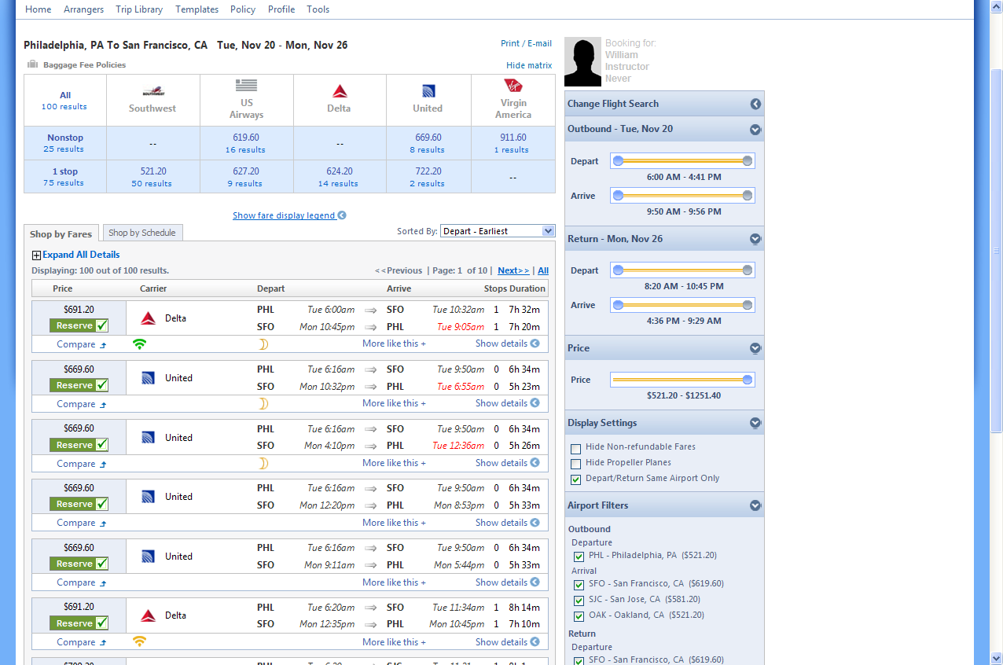

Slide 6
Online Expense Reports
Ability to add expenses from anywhere
Electronic Receipts
Automatic Workflow Routing
Electronic history of submitted and approved reports

Slide 7
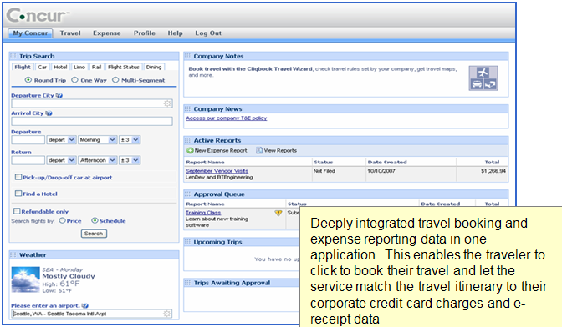
My Concur dashboard provides easy access to booking, open reports and reports to be approved.

Slide 8
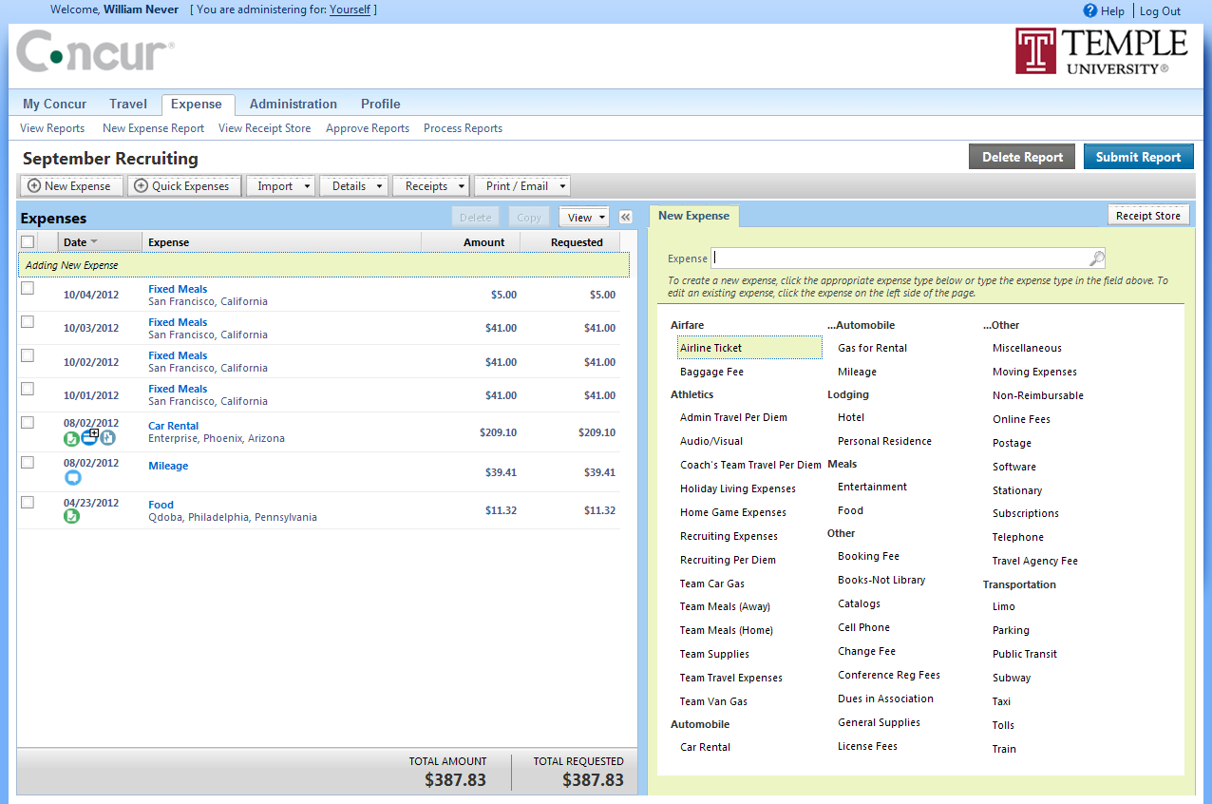

Slide 9
Concur Timeline
Requirements
Gathering
Testing
University Roll-Out
Training & Go-Live
1/2012
2/2012
3/2012
4/2012
5/2012
12/2012
Configuration
& Technical
Preparation
Training -Pilot Group
4/9-5/1
Single Sign-On
Report Development
5/1 Pilot Group Go-Live:
a) Fox Business School
b) Government Relations
c) School of Communications &Theatre
d) Dental School
e) College of Science and Technology
f) Athletics

Slide 10
Current Users
Institutional Advancement
Fox School of Business
College of Science & Technology
School of Communications & Theater
School of Podiatric Medicine
President’s Office

Slide 11
Rates & Fees
Tickets for flights cost the same as Expedia (GDS)
Reduction of booking fees from $35-$50 to $11
Benefits include 24 hours concierge service from World Travel

Slide 12
Travel And Business Expense Policy
Current Policy is 25 years old
Guideline to reimbursements
Working group has been assembled to review

Slide 13
Questions?

